Slide 1

Prompt Engineering
Dan McCreary
Distinguished Engineer
Dev Days 2023

Slide 2


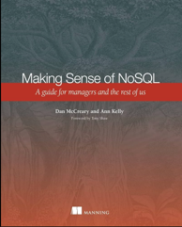


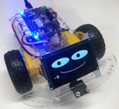


Background for Dan McCreary
Solution architect with over 35 years working with data
Worked for Bell Labs and Steve Jobs at NeXT
Author of a book on database selection “Making Sense of NoSQL”
Promoter of XML and graph query standards (GQL)
Former Distinguished Engineer working for Optum (UHG)
Built the worlds largest healthcare knowledge graph
Lead the “Generative AI Center of Excellence” at Optum
Worked with over 250 healthcare uses cases – 50 which were funded and over 10 in production
Blogger: http://medium.com/@dmccreary
Big fan of AI, robotics, MicroPython, and STEM education
Advocate for neurodiversity

Slide 3
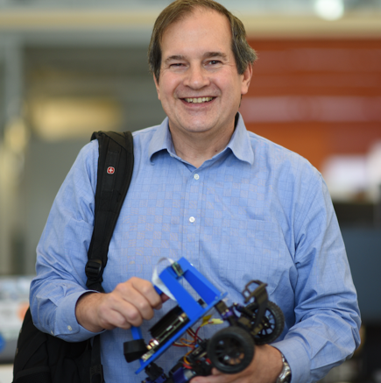
Presenter
Optum Generative AI Center of Excellence
Teaching Generative AI since March of 2021
LinkedIn: https://www.linkedin.com/in/danmccreary/
Dan McCreary
Distinguished Engineer
OptumAI

Slide 4
Today’s Talk
1
What is Prompt Engineering?
2
Why is it becoming increasingly strategic?
3
Examples: Simple to Complex
4
Resources to learn more
Notes:
Trends that matter

Slide 5

What is Prompt Engineering?
Prompt
Large Language
Model
Response
Feedback
The process of crafting a text input to a large-language model (like ChatGPT) to get better results
Good prompt engineering is an iterative process that combines elements of logic, coding, creativity and knowledge of how large-language models work
Prompt engineering skills also apply to generating images and diagrams

Slide 6

Key Question for Our Senior Leaders
Should a one-hour course on safe prompt engineering be required for all knowledge workers?
Consider: Today generative AI is only available via writer.com and Immerse. By next year, hundreds of applications will integrate powerful generative AI.

Slide 7
Sample Story
Create a “safe” environment for learning: You are a consultant for a high-school class that is teaching computational thinking and data literacy.
Examples will use this situation to avoid loss of healthcare intellectual property.

Slide 8
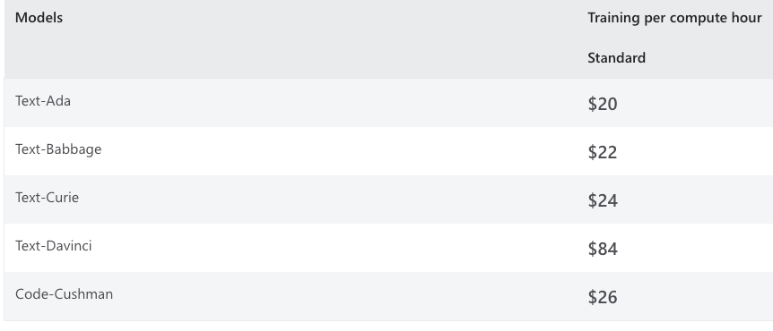
Why Has Prompt Engineering More Important Than Ever?
Public
Knowledge
Internet
Large Language
Model
Response
Firewall
Private
Knowledge
Intranet
Two options: Prompts vs. Fine Tuning
Cost of fine-tuning and hosting 100B+ parameter large language models is not economically viable.
Hosting an instance of a fine-tuned model is around $2,000/day
Microsoft Azure has postponed hosting fine-tuned models due to lack of hardware capacity.
https://azure.microsoft.com/en-us/pricing/details/cognitive-services/openai-service/#pricing

Slide 9
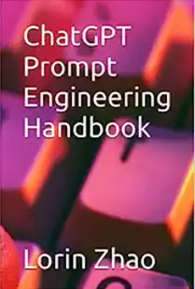
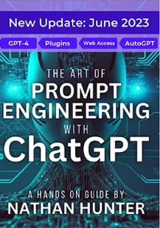



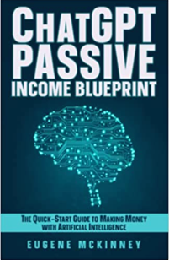
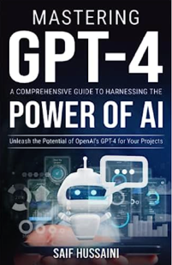
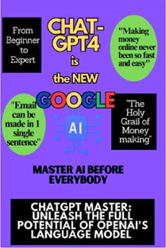
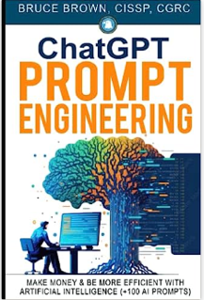
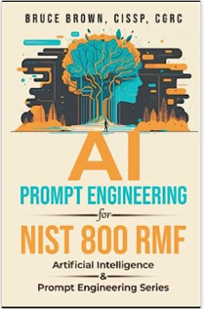
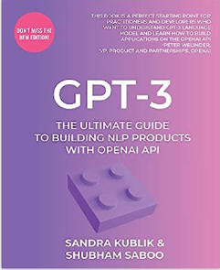
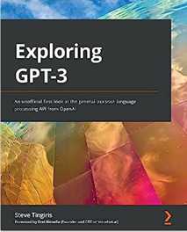


Many Books Available on Prompt Engineering
The promise: making a few quick millions (on the side) without needing any programming or math!
Question: What percentage of these books have been written by ChatGPT?

Slide 10
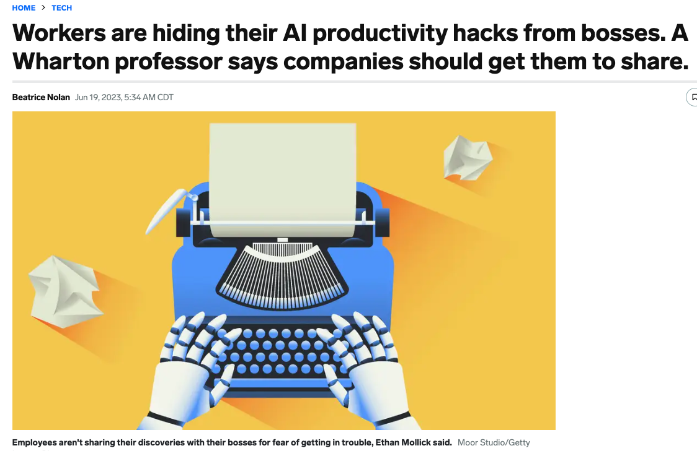
Many Employees Learn Prompt Engineering “on the side”

Slide 11
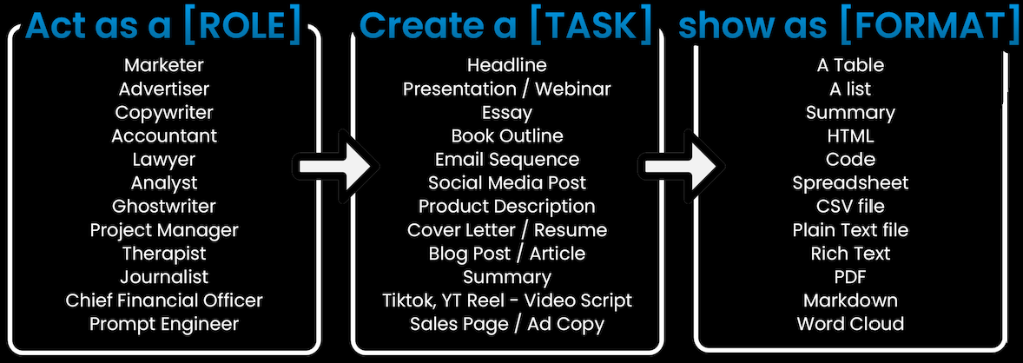
Basic Prompt Structure
As a [ROLE] perform [TASK] return [FORMAT] at grade level [GRADE].
Diagram, Flowchart etc.
(500+ plugins)

Slide 12
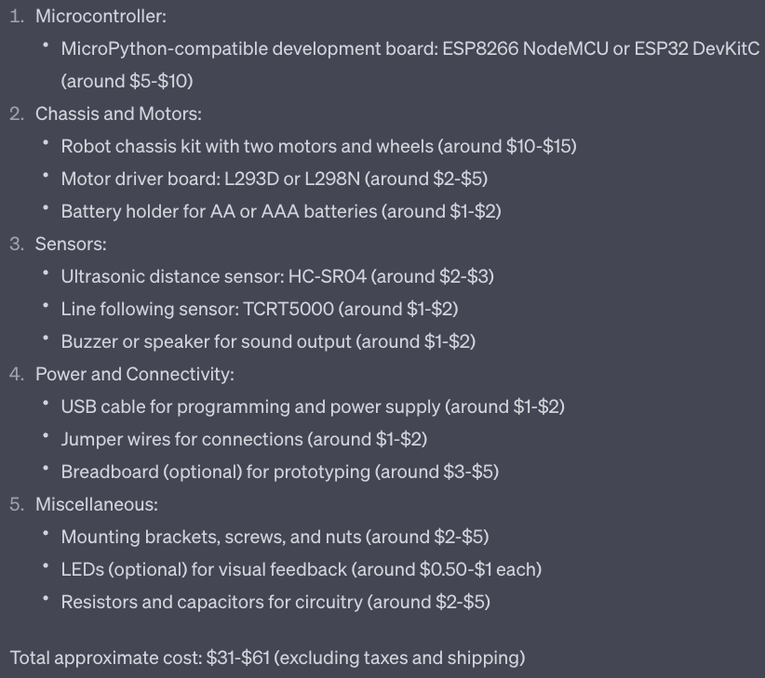
Example
As a senior robot designer with a focus on designing low-cost robots for education, create a list of parts for an inexpensive robot that teaches the principals of computational thinking using micropython. Return a parts list with approximate costs and the total parts costs.
Note: The Optum STEM Robot is only $19
https://stem.optum.com/optum-robots/

Slide 13
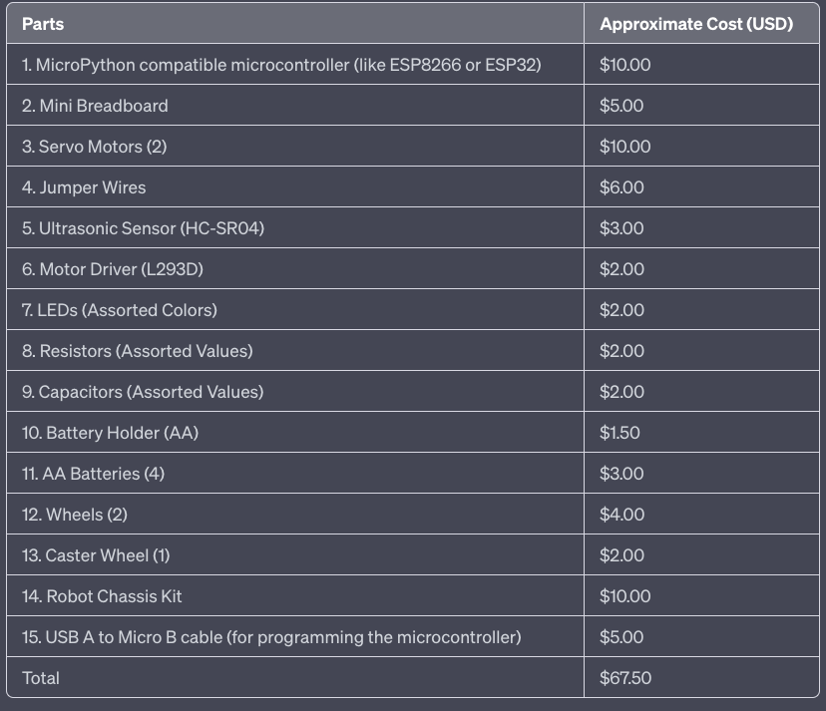
Changing Output Format
Add the following to the end of the prompt:
Return the results as a Markdown table.
It got 14 out of 15 correct. “When asked why a “servo motor”? It suggested a DC motor.

Slide 14
Single Shot Example: Application Classification
You are an expert on desktop applications and how they are classified according to a taxonomy of desktop apps. You created the following taxonomy of applications:
1. Word Processing
2. Spreadsheet
3. Presentation
4. Graphics Editor
4.1 Image Editor
4.2 Vector Image Editor
5. Notetaking
6. Accounting
7. Mind Mapping
For example, if I gave you "Excel" you would return "2. Spreadsheet" like this:
Excel: 2. Spreadsheet
Classify the following application according to the taxonomy above:
Gimp:
Example
4.1 Image Editor

Slide 15
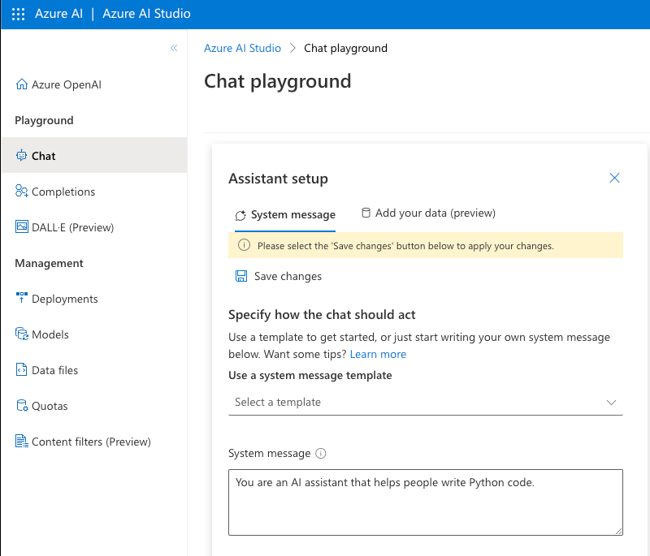
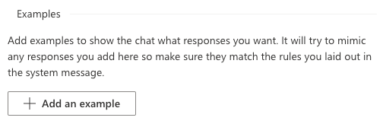
Azure Chat Playground “Examples”

Slide 16
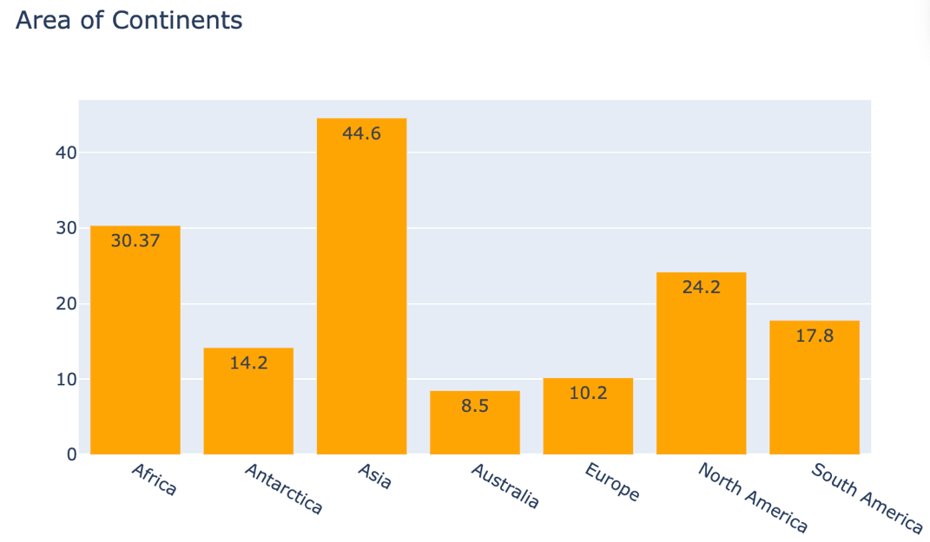
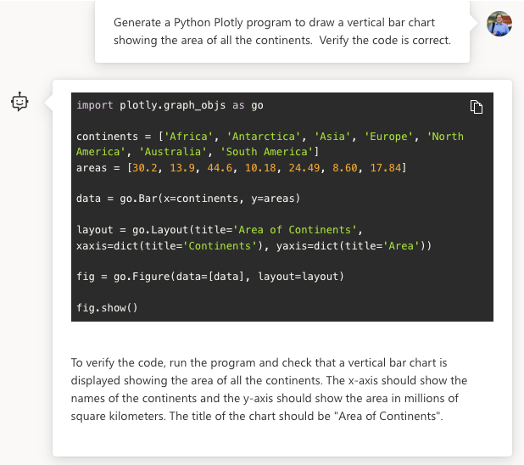
Verification
Prompt: Create a Python plotly program to draw a vertical bar chart
showing the area of all the continents. Verify the code is correct.

Slide 17
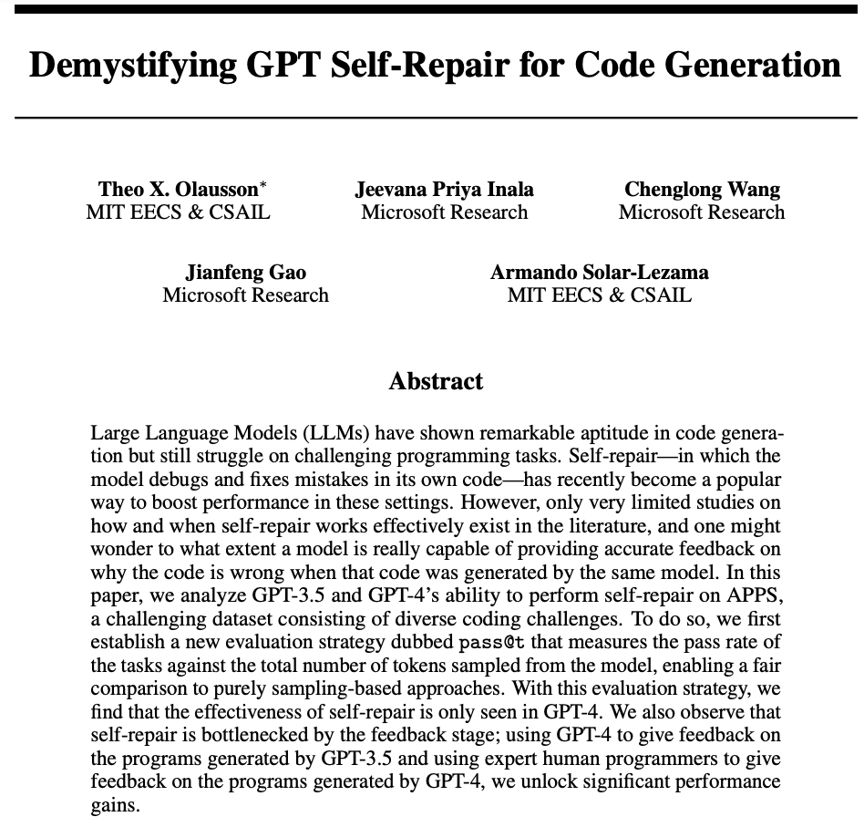
Generative AI Self-Repair
Summary: modest gains in GPT-4
Self repair Paper: https://arxiv.org/pdf/2306.09896.pdf
Notes:
https://arxiv.org/pdf/2306.09896.pdf

Slide 18
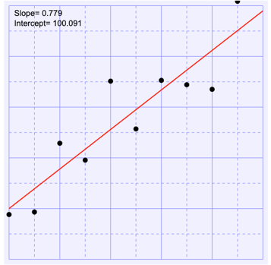
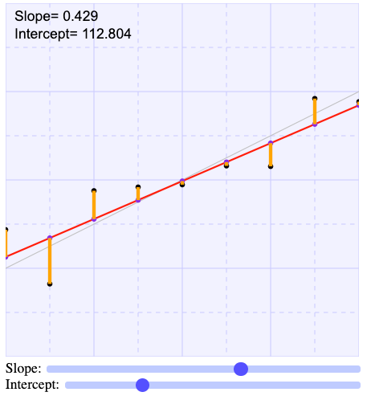
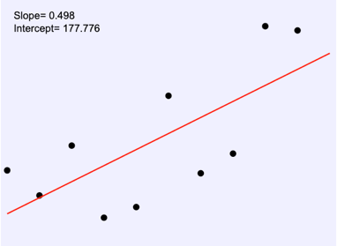
Prompt Chaining
Write a series of prompts that work together to solve a problem
Larger problems are broken down into smaller tasks
Example:
Generate some ideas for blog posts on teaching linear regression
Take idea #3 and ask “what are the common misconceptions” on this topic?
Create an outline of a blog on how to break this into small steps.
Generate some web drawings of slope and intercept
Create some interactive web applications to demonstrate this topic?

Slide 19
Prompt Chaining: SAS to Python
Challenge: You are given some SAS code that is 15 years old but has no documentation and no regression tests. The developers that wrote the SAS code have moved on a long time ago. You don’t know SAS, but you know Python.
Explain what this SAS code does.
Generate an acceptance test plan for this SAS code.
Add documentation to this SAS code.
Generate sample data to test this SAS code.
Convert this SAS code to Python.
Add detailed documentation to the new Python code.
Generate unit test for the new Python code.
Take home point: By breaking a large problem down into steps you can make generative AI work!

Slide 20
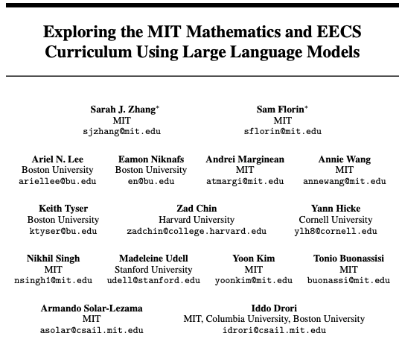
How Important is Prompt Engineering in Knowledge Graph Synthesis?
Note: Paper was withdrawn Did not receive permission to release the model fine-tuned on the data.
Answer: Very important!
https://arxiv.org/pdf/2306.08997.pdf
Notes:
https://arxiv.org/pdf/2306.08997.pdf https://arxiv.org/abs/2306.08997

Slide 21
Many Different Prompt Strategies
You are an MIT Professor of Computer Science and teaching Introduction to Python.
Zero-shot Learning: Without any data or example questions in the context, the LLM attempts to answer the question directly.
Few-shot Learning: The LLM is provided with a few example questions and answers in the context to guide its understanding of the task.
Chain-of-Thought (show your work): Uses prompt engineering to elicit a step-by-step answer.
Critique: An LLM generates an answer and a critique of that answer. The answer is iteratively refined using the critiques. Example: self-repair.
Tree-of-Thought: Uses prompt engineering to generate a tree of answers and then reflects on each of the answers. Then combine the best of the results for a final result.
Program Synthesis: The LLM is prompted to write a program that solves the problem, and then the program is run in an interpreter.
Expert Prompting: A novel contribution of this work is to use the LLM to identify experts in the field, generate answers as if the experts wrote them, and combine the experts’ answers by collaborative decision-making.
…and then also use fine-tuning on smaller LLMs.

Slide 22
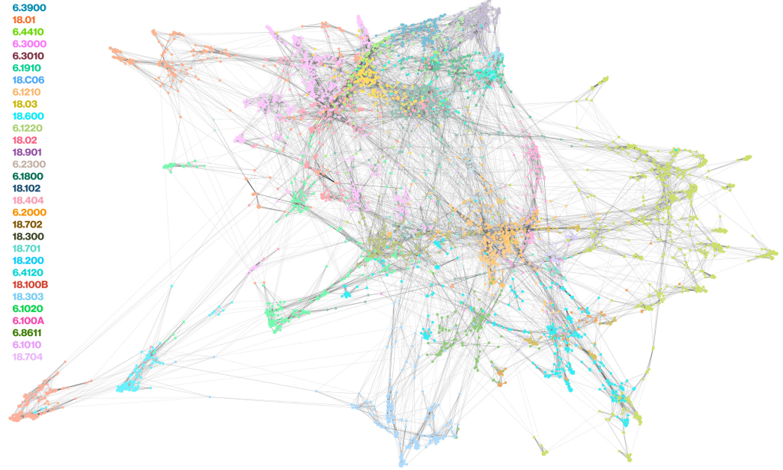
Giffy Image of Related Quiz Questions from MIT Courses in EE/CS
Circuits
Circuits

Slide 23
Tree of Thoughts (works best on GPT-4)
Computer
Science
Perspective
Psychology
Perspective
Instructional
Designer
Perspective
Reflection
Reflection
Reflection
Final Result
Prompt: There are three experts considering how to teach a Python class on machine learning:
a computer scientist
a psychologist
an instructional designer
For each expert, give their opinion on how to teach a specific topic. They will then reflect on each other’s viewpoints and reconsider their own perspective. At the end, combined the strengths of each perspective to create a final suggestion.

Slide 24
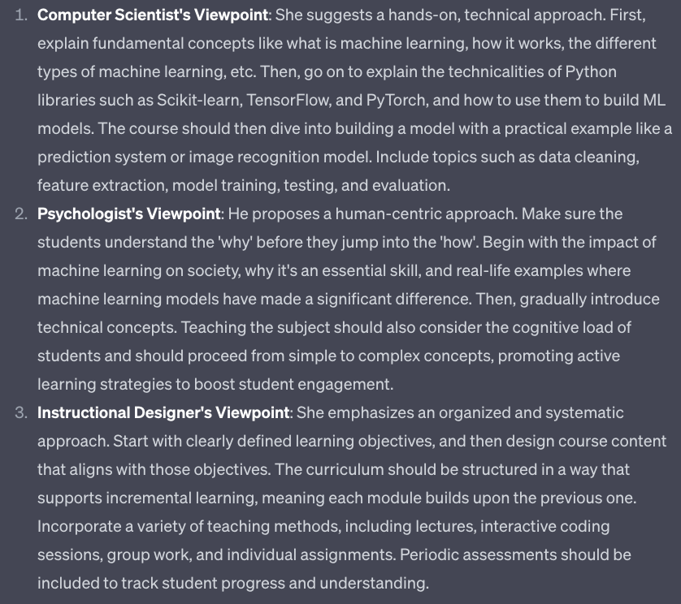
Viewpoints

Slide 25
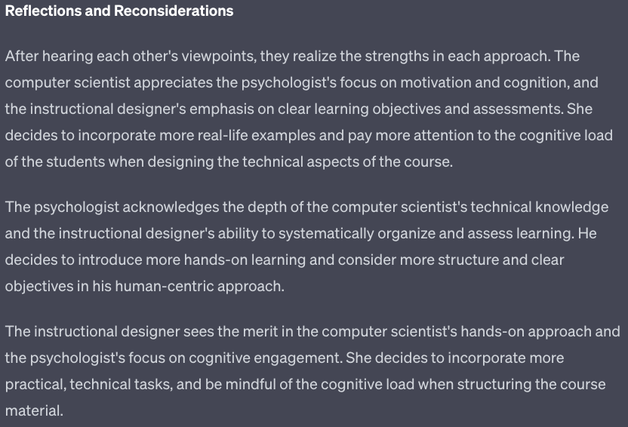
Reflections and Reconsiderations

Slide 26
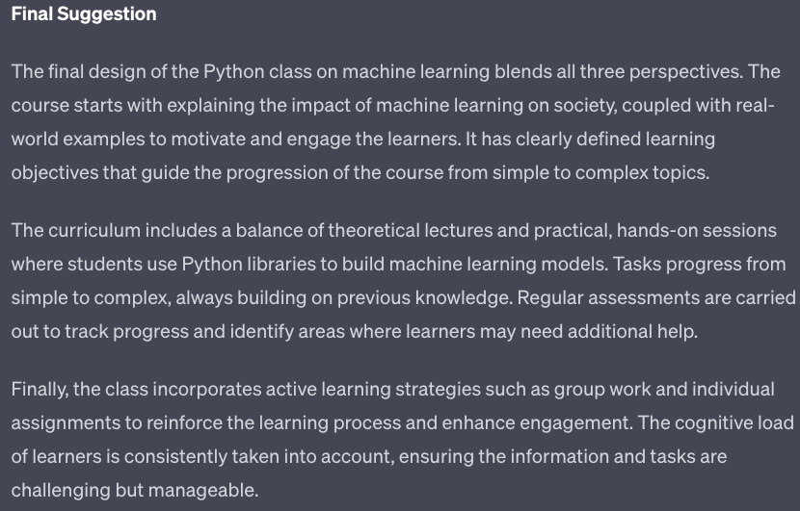
Final Suggestion

Slide 27
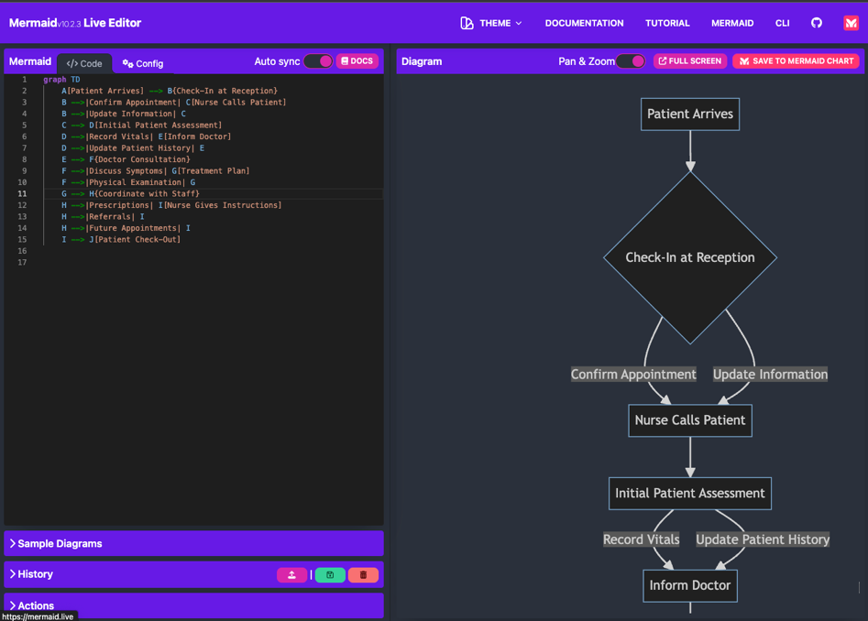
Prompts for Generating Workflows
Prompt: Generate a flowchart of a process of interviewing a patient in an exam room and making sure the staff is coordinated for the clinic. Generate a mermaid flowchart.

Slide 28

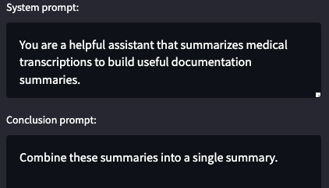
System and Conclusion Prompts
System
Clinical Notes
Conclusion
The system prompt is placed before a document. The conclusion prompt is place at the end of a document

Slide 29
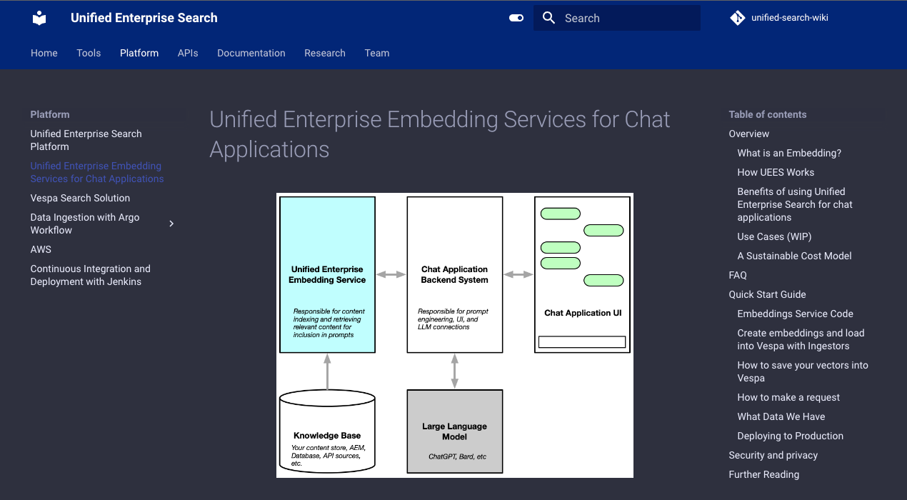
Embeddings Everywhere
Course being taught in partnership with the Unified Search Team (Pete Edstrom)
Focus on how embeddings are used in generative AI applications

Slide 30
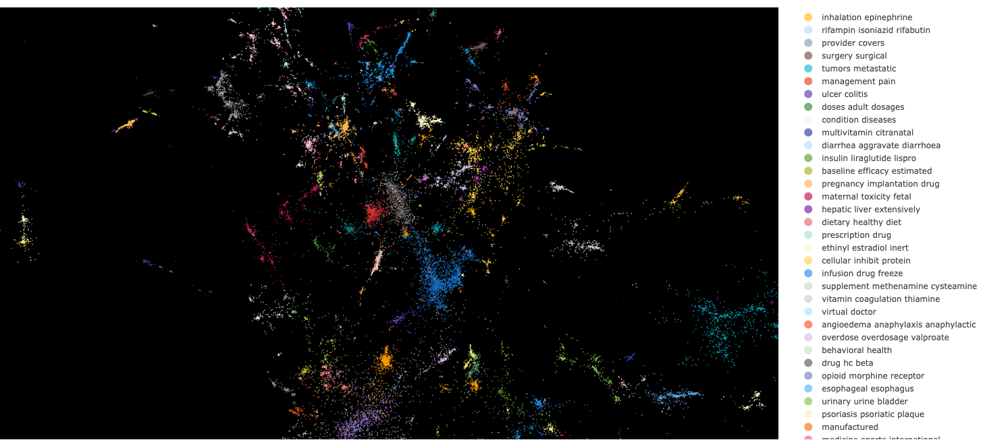
Sample 3D Viewer of Healthcare Concepts
Unified Search Vector Visualization Tool: https://dev.tools.search.optum.com/#/visualize

Slide 31
GenAI Intelligent Agent Architecture
Key
LLM Task
New GenAI App
English
Other GenAI Apps
Optum Infrastructure
Single Task
Multiple Tasks
GenAI Wrapper
REST APIs
English
Agent Safety Guardrails
Goal Decomposition
Task Ordering
GenAI Wrapper
Knowledge
Graph
Estimation
Logging
Scheduling
English
Document Cracking
Embedding
Verification
Collection
Notification
Goal: define loosely coupled resilient architecture where clearly defined interfaces allow components to be swapped in and out has technology changes and new contracts are negotiated.

Slide 32
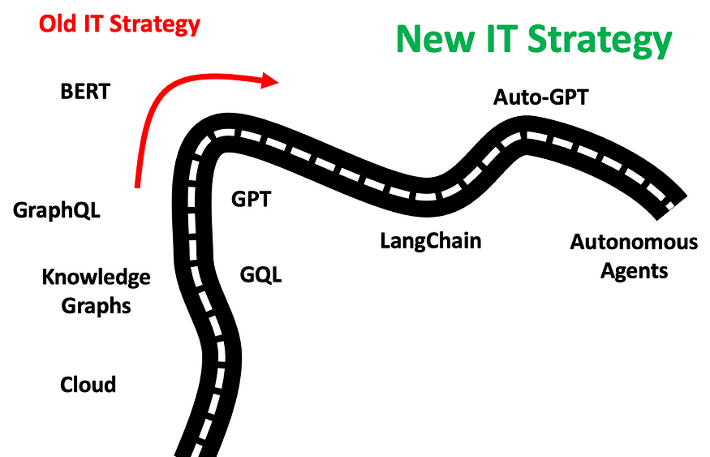
LangChain, AutoGPT and Agents
Course taught with Neal Kelly and Michael Milo (Naviguard)

Slide 33

LangChain
A Python "Framework" for building applications with large-language models
Data-aware: connect a language model to other sources of data
Agentic: allow a language model to interact with its environment
Components: abstractions for working with language models, along with a collection of implementations for each abstraction. Components are modular and easy-to-use, whether you are using the rest of the LangChain framework or not
Off-the-shelf chains: a structured assembly of components for accomplishing specific higher-level tasks
Large and growing community – almost 50K Stars on GitHub

Slide 34
Sample ChatBot Question
What is the status of my ticket?
Is this a FAQ?
FAQ
Text
Question
Yes
Return “Nearest” FAQ
No
Find Nearest
Query
DB
Run Query
Return Query Result
With Parameters

Slide 35
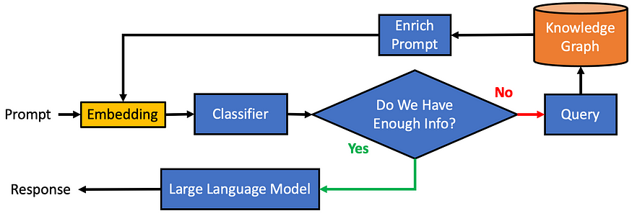
LangChain Uses Composability and Depends on Embeddings
Note the iterative structure of the workflow.

Slide 36
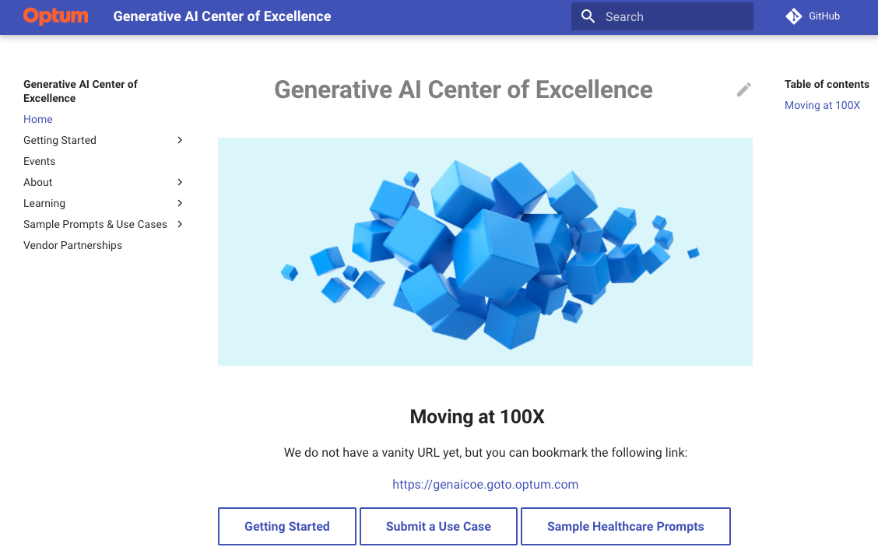
Generative AI Center of Excellence Microsite
Search
Bookmarkable URL: https://genaicoe.goto.optum.com

Slide 37
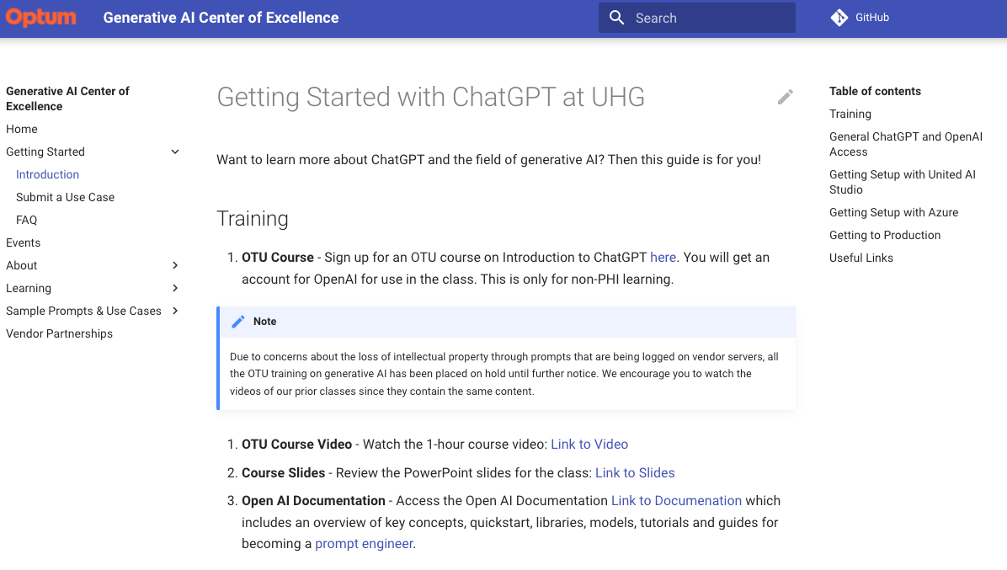
Detailed Getting Started Page

Slide 38
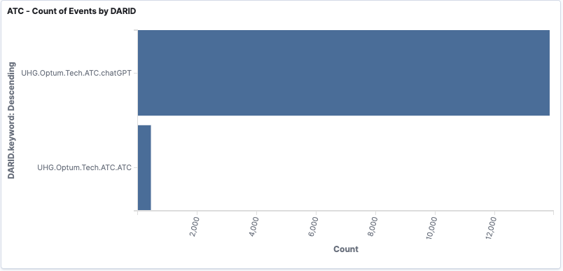
Optum Pixel Report on GenAI CoG Microsite Page Views (trailing 30-days)
The Generative AI Center of Excellence continues to get around 15,000 views per month.
(link to Kibana dashboard)

Slide 39

Q&A
Duration of segment

Slide 41


Thank you!
Prompt Engineering Feedback

